Slide 1
Retirement Plan Consulting
Overview of Services

Slide 2
Table of Contents
      About RPAG
      About Us
      Service Structure
      Core Services
      Summary

Slide 3
About RPAG
A national alliance that provides premier technology and resources for retirement plan professionals.

Slide 4
RPAG At-a-Glance
RPAG’s size and scale provides its members with resources to apply their deep knowledge, creative thinking and industry experience to help deliver a tailored solution.
$800B
IN ASSETS UNDER INFLUENCE
80K
RETIREMENT
PLANS SERVED
7M
PLAN
PARTICIPANTS
2,000+
RPAG
FINANCIAL PROFESSIONALS
      INTEGRATED
      Technology built to help make
      Your plan more efficient.
      DEDICATED
      Retirement plan specialists
      dedicated to their clients.
As of 8/31/2021.
ACR# 3860323 10/21

Slide 5
Depth & Breadth
As a member of RPAG, we are backed by an extensive team of retirement plan experts. We leverage the RPAG platform to work closely with our clients, becoming strategic partners in the trenches, thinking about their business as much as they do.
CFA® CHARTERHOLDERS
ERISA
SPECIALISTS
FINANCIAL PROFESSIONAL SUPPORT TEAM
RFP/BENCHMARKING
SPECIALISTS
PLAN CONSULTANTS

Slide 6
Who We Are
Driven by robust technology, systems and services, RPAG financial professionals have a unique ability to help create successful retirement plan outcomes for plan sponsors and participants alike.
MOST ADVISORS
RPAG FINANCIAL PROFESSIONALS
Plan
Governance
Investment
Analysis
Investment
Analysis
Fiduciary Education
Fee Benchmarking
GUIDANCE
SUPPORT
Financial Wellness
Plan
Design
ERISA Compliance
TDF Suitability
CONSULTING

Slide 7
About Us
Helping create successful retirement plan outcomes for plan sponsors and plan participants.

Slide 8
Mission Statement
Helping create successful retirement plan outcomes for plan sponsors and plan participants.

Slide 9
Retirement Services
TARGET DATE FUND CONSULTING
Comprehensive and ongoing fiduciary guidance, training and support to mitigate potential liabilities.
FEE BENCHMARKING
RFP driven process to ensure apple-to-apple comparisons and to help maximize a plan’s negotiating leverage
INVESTMENT ANALYSIS
Proprietary fund ranking system that aims to enhance outcomes, manage risks and reduce fiduciary exposure
TARGET DATE FUND CONSULTING
Advanced risk-based suitability process to identify a “best-fit” target date fund series that is right for your plan
COURAGEOUS PLAN DESIGN
Plan design assessments that strive to increase an employer’s benefits return on investment (ROI) while striving to enhance participant retirement outcomes
EMPLOYEE ENGAGEMENT
Highly customized plan participant content structured to help optimize outcomes and increase financial wellness

Slide 10

Plan Sponsor Concerns
You face a variety of concerns with regards to your retirement plan. We work with you to address any number of issues that may be on your mind.
  Complying with retirement
  plan regulations
  Adhering to fiduciary responsibilities
  Paying reasonable fees
  Offering competitive funds
  Preparing participants to retire when you need them to retire

Slide 11
Service Structure

Slide 12
Service Structure
CLIENT
FINANCIAL PROFESSIONAL
ERISA
DEPARTMENT
INVESTMENT DEPARTMENT
RFP ANALYSIS
DEPARTMENT
EMPLOYEE EDUCATION DEPARTMENT

Slide 13
Typical Implementation Tasks
TOPIC | DETAIL | TARGET MONTH | MEETING DATE/TIME
Provider Evaluation | Initial fact-finding meeting to map out plan parameters, complexity, service requirements and unique needs for recordkeeping benchmarking study | TBD
 | Service providers to be included in the study are also selected
Fiduciary Compliance | Perform fiduciary gap analysis to prioritize areas of focus | TBD
 | Review / create plan governance documents, e.g., board resolution adopting a retirement plan committee, committee member acceptances to acknowledge member’s appointment and fiduciary status, committee charter outlining the composition, scope of responsibilities and authority delegated to a plan’s committee, investment policy statement outlining the fiduciary responsibilities of the committee
 | Map out fiduciary training calendar for the next 12 months
Investment Options | Investment structure review | TBD
 | Fee structure review
 | Evaluation of existing investment lineup and alternative fund considerations
 | Qualified Default Investment Alternative (QDIA) suitability analysis and selection
 | Cash alternatives review
Provider Evaluation | Review results of recordkeeping benchmarking study | TBD
 | If applicable, negotiate changes to provider compensation and service commitments
 | If applicable, assist in the selection, coordination and review of service provider finalist presentations
Fiduciary Compliance | Approve amended / created plan governance items | TBD
Investment Options | If applicable, approve changes to investment options and/or fee structure | TBD
Provider Evaluation | Complete service provider agreements | TBD
Employee Communication | Meeting to map out a communications plan to inform participants of applicable changes | TBD

Slide 14
Fiduciary Support

Slide 15
Fiduciary Diagnostic™
ACTION ITEMS | REFERENCE MATERIALS | DOCUMENTATION | FIDUCIARY BRIEFCASE | COMMENTS
Selecting and Monitoring Fiduciaries | Education Modules 1, 2 & 3 | Documenting Fiduciaries, Consultants & Service Providers | Yes
 |  | Retirement Committee Charter | Yes
 |  | Resolution Committee Charter | Yes
 |  | Acceptance of (Designation/Appointment) | Yes
Identifying and Monitoring Parties in Interest | Education Modules 1, 2 & 3 | Documenting Parties in Interest | Yes
Selecting and Monitoring Service Providers | Education Modules 4 & 14 | Selecting and Monitoring:
 |  | - Consultants | Yes
 |  | - Plan Providers | Yes
 |  | - Auditors | Yes
 |  | Annual Fee Benchmarking | Yes
 |  | B3 Provider Analysis™ | Yes
 |  | 408(b)(2) Checklist | Yes
 |  | 408(b)(2) Disclosures | Yes
 |  | Compensation Disclosure | Yes
Understanding and Documenting Fees and Expenses | Education Modules 5 & 15 | Annual Fee Benchmarking | Yes
 |  | B3 Provider Analysis | Yes
 |  | Annual 404a-5 Disclosure | Yes
Selecting and Monitoring Plan Investments | Education Module 6 & 20 | Investment Policy Statement | Yes
 |  | Investment Scorecard™ | Yes
 |  | Target Date Fund Workbook | Yes N/A
§404(a) and §404(c) Compliance | Education Module 7 | §404(a) & §404(c) Checklist | Yes
 |  | §404(c) Notice & Policy Statement | Yes
Maintaining a Fiduciary File | Education Module 8 | Organizing Your Fiduciary File Checklist | Yes
Investing in Employer Securities | Education Module 9 | §404(c) Notice and Policy Statement Addendum | Yes N/A
Minimizing Risk: Fidelity Bond & Fiduciary Insurance | Education Module 10 | Fidelity Copy of Bond | Yes
 |  | Fiduciary Insurance Copy of Policy | Yes
Claims and Appeal Procedures | Education Module 11 | Documentation of Claims and Appeals (actual events) | Yes
Plan Demographic and Document Review | Education Module 12 | Plan Design Summary | Yes
 |  | ACAs Notice | Yes N/A
 |  | QACAs Notice | Yes N/A
 |  | EACAs Notice | Yes N/A
 |  | Initial QDIA Notice | Yes N/A
 |  | Annual QDIA Notice | Yes N/A
 |  | Safe Harbor Notice | Yes N/A
 |  | Summary Annual Report | Yes
Prohibited Transactions and Plan Solutions | Education Module 13, 18 & 19 | Due Diligence | Yes N/A
M&A and Control Groups | Education Modules 16 & 17 | Due Diligence | Yes N/A
Legal and Compliance Update | Education Module 21 |  | N/A
Notes:
Fiduciary Compliance
Who helps you to understand your fiduciary and plan management responsibilities under ERISA?
Who helps you to document your plan’s fiduciary processes, discussions and actions taken?
Who helps you to document that required tasks are completed?
Initially, we will conduct a Fiduciary Diagnostic on your plan that will be used to identify any existing gaps pertaining to your committee’s fiduciary responsibilities. Your plan’s Fiduciary Diagnostic is then reviewed and updated on a regular basis to identify upcoming plan management responsibilities and to document when required tasks are completed. Our Fiduciary Education Modules provide resources to inform and educate committee members regarding ERISA’s fiduciary requirements

Slide 16
Fiduciary Education Modules
Our Fiduciary Education Modules provide resources to inform and educate committee members regarding ERISA’s fiduciary requirements.
Fiduciary Overview | Maintaining Your Fiduciary File | 404a-5 Disclosure Regulations
Fiduciary Responsibilities | Investing in Employer Securities | Controlled Groups
Fiduciary Liabilities | Minimizing Risk Strategies | Mergers & Acquisitions
Selecting Service Providers | Claims & Appeals Procedures | Timely Deposits
Fees & Expenses | Participant Experience | Elective Contributions
Selecting Investments | Prohibited Transactions | TDF Selection
ERISA 404(a) & 404(c) | 408(b)(2) Disclosure Regulations | DOMA

Slide 17
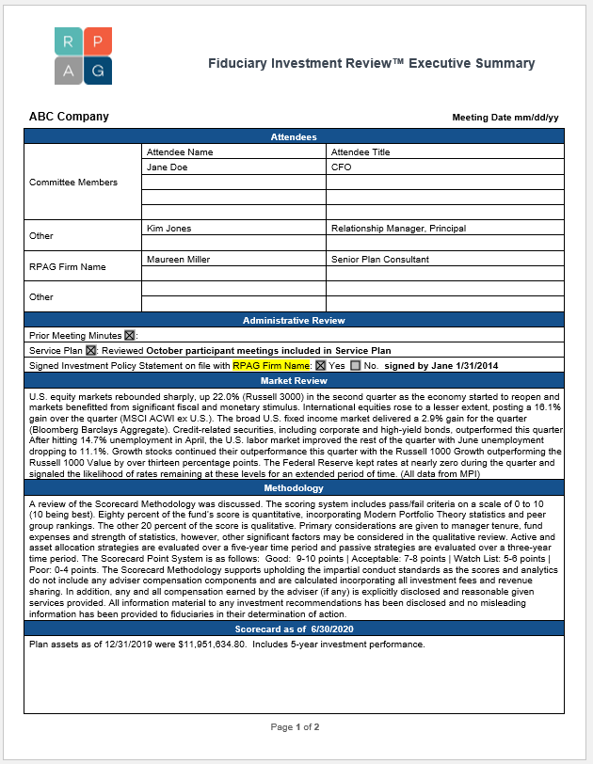
Documentation
Proper documentation is a must for plan fiduciaries. Our best practices will help make sure your i’s are dotted and your t’s are crossed.
Investment committee charter
Investment policy statement
Investment monitoring reports
Fee benchmarking reports
Fiduciary compliance checklist
Fiduciary file checklist
Required notices and disclosures
Meeting minutes

Slide 18

ERISA Guidance & Support
Navigating today’s ever-changing and increasingly complex legal and fiduciary compliance landscape can be…well…a nightmare. Our goal is to help you sleep better at night with our in-house ERISA guidance.
In-house, former practicing ERISA attorneys
Regulatory and legislative changes
Relevant litigation developments
IRS and DOL audits
Annual audit assistance
Client advocacy

Slide 19
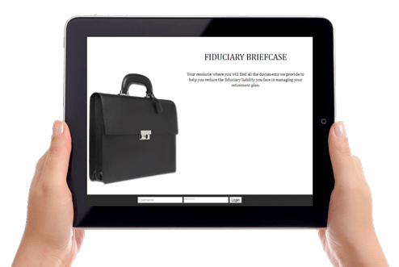
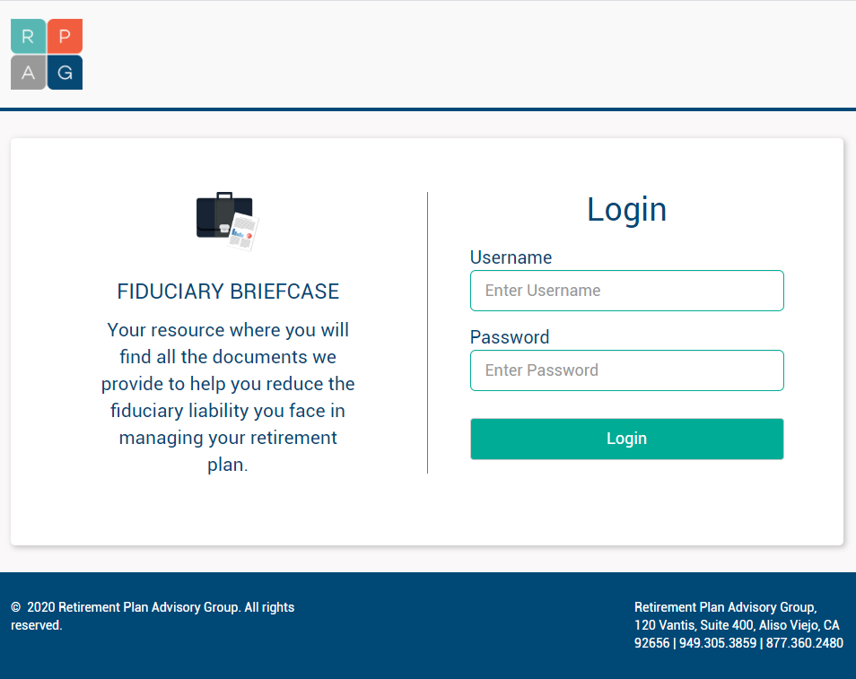
Fiduciary Briefcase™
Our online, cloud-based file storage system provides 24/7 access to all of your important fiduciary documents.
Plan documents
Committee charter
Investment policy statement
Meeting minutes
Investment monitoring reports
Fee benchmarking studies
Required disclosures
and notices
Participant education
materials

Slide 20
Investment Analysis

Slide 21
Investment Due Diligence Snapshot
PEOPLE | Investment Committee is comprised of 7 CFA charter holders with 128 years of combined investment experience
PROCESS | Process incorporates a proprietary, quantitative fund Scorecard™ and a thorough qualitative review by our Investment Committee to identify skillful managers
SCOPE | Leverage over $800 billion¹ in assets under advisement to gain access to key investment personnel
KEY DIFFERENTIATORS | Process incorporates: Separate scoring methods for actively managed, passively managed and asset allocation portfolios A significant qualitative review process by 7 CFA charter holders and a team of investment research analysts Custom style benchmarks and peer group universes for actively managed and passively managed portfolios to ensure accurate comparisons Custom benchmark indexes and risk-based peer groups for all TDF-vintages (2020, 2025, etc.) to ensure accurate comparisons Rolling 5-year peer group rankings over the last 10 years to confirm the reliability / consistency of fund results during different market cycles

Slide 22


Institutional-Level Due Diligence
STANDARD METRICS
  Average returns
  Broad benchmarks
  Broad peer groups
  Broad style analysis
  Alpha
  Beta
  Standard deviation
RPAG METRICS
  Rolling returns
  Custom benchmarks
  Custom peer groups
  Style drift
  Information ratio
  Upside capture ratio
  Downside capture ratio

Slide 23

Institutional-Level Due Diligence
FUND SCORE
WATCH LIST
FUND ADDITION
FUND REMOVAL
In-depth quantitative analysis
Deep qualitative analysis
CFA® charterholder-led Investment Committee review
Plan liabilities review

Slide 24
Target Date Fund Sustainability
One of the most widely used investment options in defined contribution plans
97%
77%
52%
Participants using TDFs
Participants offered TDFs
Participants with entire account invested in a single TDF
Prolific TDF prevalence necessitates increased due diligence by fiduciaries

Slide 25
TDF Results
Calendar Year Range of Returns for 2010-dated TDFs (2006-2010)¹
2010
2009
-42
2008
-11
2007
2006
-50.00
-40.00
-30.00
-20.00
-10.00
0.00
10.00
20.00
30.00
40.00
Worst Case Return
Best Case Return
31%
Extreme differences in returns create significant risks for plan participants and plan fiduciaries

Slide 26
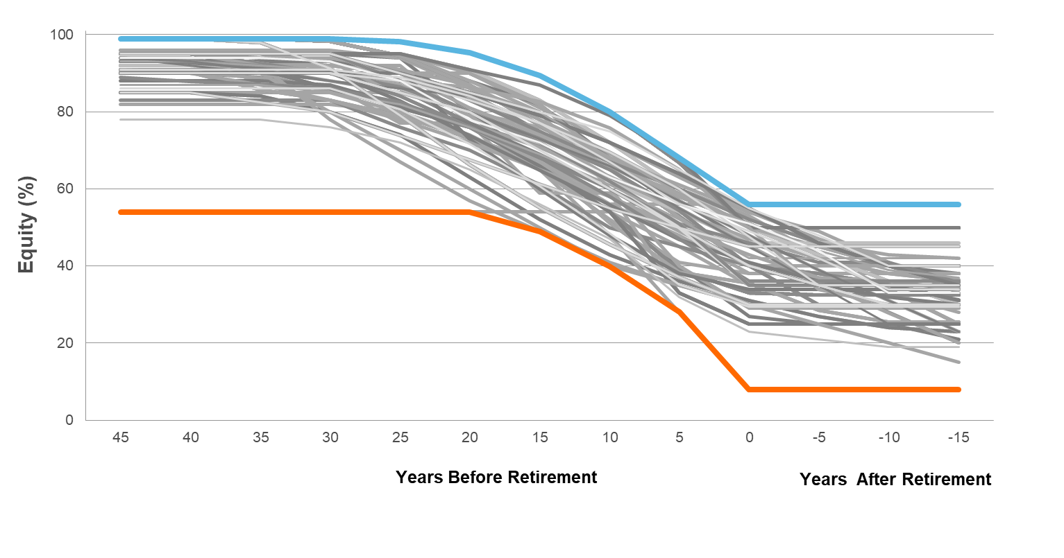
TDF Results
TDF equity allocations at retirement can vary by as much as 48%
TDFs have never been more widely available or more diverse
56%
8%

Slide 27
DOL Tips
What to Remember When Choosing Target Date Funds
Establish a process for comparing and selecting TDFs. In general, plan fiduciaries should engage in an objective process to obtain information that will enable them to evaluate the prudence of any investment option made available under the plan. For example, in selecting a TDF you should consider prospectus information, such as information about performance (investment returns) and investment fees and expenses. You should consider how well the TDF’s characteristics align with eligible employees’ ages and likely retirement dates. It also may be helpful for plan fiduciaries to discuss with their prospective TDF providers the possible significance of other characteristics of the participant population, such as participation in a traditional defined benefit pension plan offered by the employer, salary levels, turnover rates, contribution rates and withdrawal patterns.
Establish a process for the periodic review of selected TDFs. Plan fiduciaries are required to periodically review the plan’s investment options to ensure that they should continue to be offered. At a minimum, the review process should include examining whether there have been any significant changes in the information fiduciaries considered when the option was selected or last reviewed. For instance, if a TDF’s investment strategy or management team changes significantly, or if the fund’s manager is not effectively carrying out the fund’s stated investment strategy, then it may be necessary to consider replacing the fund. Similarly, if your plan’s objectives in offering a TDF change, you should consider replacing the fund.
Understand the fund’s investments – the allocation in different asset classes (stocks, bonds, cash), individual investments, and how these will change over time. Have you looked at the fund’s prospectus or offering materials? Do you understand the principal strategies and risks of the fund, or of any underlying asset classes or investments that may be held by the TDF? Make sure you understand the fund’s glide path, including when the fund will reach its most conservative asset allocation and whether that will occur at or after the target date. Some funds keep a sizeable investment in more volatile assets, like stocks, even as they pass their “target” retirement dates. Since these funds continue to invest in stock, your employees’ retirement savings may continue to have some investment risk after they retire. These
funds are generally for employees who don’t expect to withdraw all of their 401(k)-account savings immediately upon retirement but would rather make periodic withdrawals over the span of their retirement years. Other TDFs are concentrated in more conservative and less volatile investments at the target date, assuming that employees will want to cash out of the plan on the day they retire. If the employees don’t understand the fund's glide path assumptions when they invest, they may be surprised later if it turns out not to be a good fit for them.
Review the fund’s fees and investment expenses. TDF costs can vary significantly, both in the amount and types of fees. Small differences in investment fees and costs can have a serious impact on reducing long term retirement savings. 2 Do you understand the fees and expenses, including any sales loads, for the TDF? If the TDF invests in other funds, did you consider the fees and expenses for both the TDF and the underlying funds? If the expense ratios of the individual component funds are
substantially less than the overall TDF, you should ask what services and expenses make up the difference. Added expenses may be for asset allocation, rebalancing and access to special investments that can smooth returns in uncertain markets, and may be worth it, but it is important to ask. 2 A difference of just one percentage point in fees (1.5% as compared with 0.5%) over 35 years dramatically affects overall returns. If a worker with a 401(k)-account balance of $25,000 averages a seven percent return, the worker will have $227,000 at retirement with the lower fee and $163,000 with the higher fee, assuming no further contributions. U.S. Department of Labor, Employee Benefits Security Administration, A Look At 401(k) Plan Fees, at http://www.dol.gov/ebsa/publications/401k_employee.html.
Inquire about whether a custom or non-proprietary target date fund would be a better fit for your plan. Some TDF vendors may offer a pre-packaged product which uses only the vendor’s proprietary funds as the TDF component investments. Alternatively, a “custom” TDF may offer advantages to your plan participants by giving you the ability to incorporate the plan’s existing core funds in the TDF. Nonproprietary TDFs could also offer advantages by including component funds that are managed by fund managers other than the TDF provider itself, thus diversifying participants’ exposure to one investment provider. There are some costs and administrative tasks involved in creating a custom or nonproprietary TDF, and they may not be right for every plan, but you should ask your investment provider whether it offers them.

Slide 28
DOL Tips
Develop effective employee communications. Have you planned for the employees to receive appropriate information about TDFs in general, as a retirement investment option, and about individual TDFs available in the plan? Just as it is important for the plan fiduciary to understand TDF basics when choosing a TDF investment option for the plan, employees who are responsible for investing their individual accounts need information too. Disclosures required by law also must be considered. The Department published a final rule that, starting for most plans in August 2012, requires that participants in 401(k)-type individual account retirement plans receive greater information about the fees and expenses associated with their plans, including specific fee and expense information about TDFs and other investment options available under their plans. The Department of Labor is also working on regulations to improve the disclosures that must be made to participants specifically about TDFs. For example, in addition to general information about TDFs, the proposed regulations call for disclosures to include an explanation that an investment in a TDF is not guaranteed and that participants can lose money in the fund, including at and after the target date. Check EBSA’s website for updates on regulatory disclosure requirements.
Take advantage of available sources of information to evaluate the TDF and recommendations you received regarding the TDF selection. While TDFs are relatively new investment options, there are an increasing number of commercially available sources for information and services to assist plan fiduciaries in their decision-making and review process.
Document the process. Plan fiduciaries should document the selection and review process, including how they reached decisions about individual investment options.
Related Information
From the Department of Labor:
  • Investor Bulletin: Target Date Retirement Funds
  • A Look at 401(k) Plan Fees
  • Meeting Your Fiduciary Responsibilities
  • Understanding Retirement Plan Fees and Expenses
  • Understanding Your Retirement Plan Fees
  • Selecting and Monitoring Pension Consultants – Tips for Plan Fiduciaries
From the SEC:
  • Beginners’ Guide to Asset Allocation, Diversification, and Rebalancing
  • Invest Wisely: An Introduction to Mutual Funds
  • Mutual Fund Fees and Expenses
From the Financial Industry Regulatory Authority (FINRA):
  • Fund Analyzer

Slide 29
Disclosure
The Pinnacle Planning Group, LLC is a member of Retirement Plan Advisory Group™ (RPAG™). The consulting services described in this presentation reflect services that can be provided to your company as a result of our membership with RPAG. This includes, but is not limited to, investment due diligence, RFP and fee benchmarking, plan design and fiduciary review and communication services.
An investor should carefully consider the investment objectives, risks, charges and expenses carefully before investing. Go to the investment company’s website for a prospectus that contains this and other information. The prospectus should be read carefully before investing.
RPAG is not in the business of providing legal advice with respect to ERISA or any other applicable law. The materials and information do not constitute, and should not be relied upon as, legal advice. The materials are general in nature and intended for informational purposes only.
All content, including any brochures or other materials designed for potential use with plan sponsors, fiduciaries, and plan participants, must be reviewed and approved by the compliance and legal department(s) of the financial professional and/or firm prior to any use to confirm that they meet the firm’s legal and compliance policies and standards. The financial professional and his/her firm are solely responsible for the use of content and any materials included herein, and for ensuring that all services provided by the financial professional conform to the firm’s legal and compliance policies and standards.
All investments involve varying levels and types of risks. These risks can be associated with the specific investment, or with the marketplace as a whole. Loss of principal is possible.
The target date is the approximate date when investors plan on withdrawing their money. Generally, the asset allocation of each fund will change on an annual basis with the asset allocation becoming more conservative was the fund nears target retirement date. The principal value of the funds is not guaranteed at any time including at and after the target date.
Mutual funds are sold by prospectus only. Before investing, investors should carefully consider the investment objectives, risks, charges and expenses of a mutual fund. The fund prospectus provides this and other important information. Please contact your representative or the Company to obtain a prospectus. Please read the prospectus carefully before investing or sending money.
The RPAG Scorecard System is a ranking of funds in approximately 30 asset classes to identify skillful managers utilizing quantitative and qualitative factors. Scores range from 1 to 10.
Securities offered through Triad Advisors, LLC (member FINRA/SIPC). Investment advice offered through Resources
Investment Advisors LLC, an SEC-registered investment adviser. Pinnacle Planning Group, RPAG and Resources Investment
Advisors, LLC are separate entities from Triad Advisors, LLC

